Slide 1
EE6306: ASIC Design Design of Mini Stereo Digital Signal Audio Processor (MSDAP)
By:
Merin Thomas (mxt142430)
Lavanya Samiti Parameswara (lxs141630)

Slide 2
Objective
The objective of this project are to:
Implementation a Mini Stereo Digital Audio Processor (MSDAP) in RTL Verilog.
Test bench was written to verify the complete functionality of the design.
Synthesize the RTL code using design vision.
Layout generation using IC compiler.
Report of area, timing and power.

Slide 3
Algorithm Description
The MSDAP will focus on the FIR Digital filtering for the hearing aid application, which involves the following linear convolution:
Where x (n) and y (n) are the input and output audio sequences, and h (k) are filter coefficients with the filter order N.
The steps involved in computing the linear convolution shown above is discussed in detail below:
y(n) = h(0)x(n-0) + h(1)x(n-1) + h(2)x(n-2) + …… + h(N)x(n-N)
h (0), h (1), h (2)… h (N) are expressed in terms of POT.

Slide 4
In order to reduce the hardware complexity of using a shifter of up to 16 bits, a one bit shifter is employed in the design. Accordingly, the above expression is transformed to –
Where u₀, u₁, u₂, u₃ … u₁₆ are addition/subtraction of the input samples defined by the r_{j} values.
u_{j} = x_{j} (1) + x_{j} (2) + …. + x_{j} (r_{j}) 1≤ j ≤ 16
Where x_{j} (l) є {±x (n-k)}, 1≤ l ≤ r_{j}
With this approach, MSDAP can implement two FIR filters for left and right channels and the order of the filter can go up N = 255.

Slide 5
Block Diagram

Slide 6
As we can see from the block diagram above, we have input signals Sclk, Dclk, Start, Reset_n, Frame, InputL/R and output signals InReady, Outready, OutputL/R to and from the MSDAP chip respectively, from the controller system.
Function of signals Sclk : Sclk is the system clock that is used to synchronize all the control signals and IO signals. All the state changes and the computation happen with the negative or falling edge of the System clock. The frequency of the Sclk determines the frequency of operation of the entire system/ chip. This is an input signal to the MSDAP from the controller.
Dclk : Dclk is the Data clock that is used as the timing reference to receive and send the input samples. A bit is received or sent at the falling edge of the Dclk. Hence to receive a 16 bit data, 16 Dclk cycles are required. One Dclk is 35 Sclk cycles. This is an input signal to the MSDAP from the controller.
Frame : Frame is an input signal from the controller to the MSDAP. While sending or receiving the input or output to or from the MSDAP, the Frame is set high. Frame signifies the start of the first bit of data-input, output, Rj or co-efficient. Frame is used as active high signal and is made high for one Dclk cycle. After receiving the first bit of the data, the Frame goes inactive i.e. low. Frame is made active after every 16 Dclk cycles and hence a 16 bit data is received between two successive Frames.

Slide 7
Start : Start is an asynchronous input signal from the Controller to MSDAP. It is used to indicate the start of the FSM and initialization of chip begins. Until then the chip is said to be idle. Start is an active high input signal.
Reset_n : Reset is an active low asynchronous input signal to the MSDAP. The chip goes to the reset mode when this signal is applied.
InputL : This is a one bit wide left input channel. It allows left co-efficient, Rj values and left input audio samples in serial format.
InputR : This is same as InputL but used for the right audio channel.
InReady : InReady is an input signal to the Controller from the MSDAP which is set high when the chip is ready to receive the data from both the channels. InReady is aligned with the Frame.
OutputL : This is a one bit wide left output channel. It allows left output audio samples in serial format.
OutputR : This is same as OutputL but used for the right audio channel.
OutReady : It is an output signal from the MSDAP to the Controller that goes high when the output is ready to be sent. It goes low when the last bit of the output data sample is sent. This signal is aligned with the rising edge of the Frame signal.

Slide 8
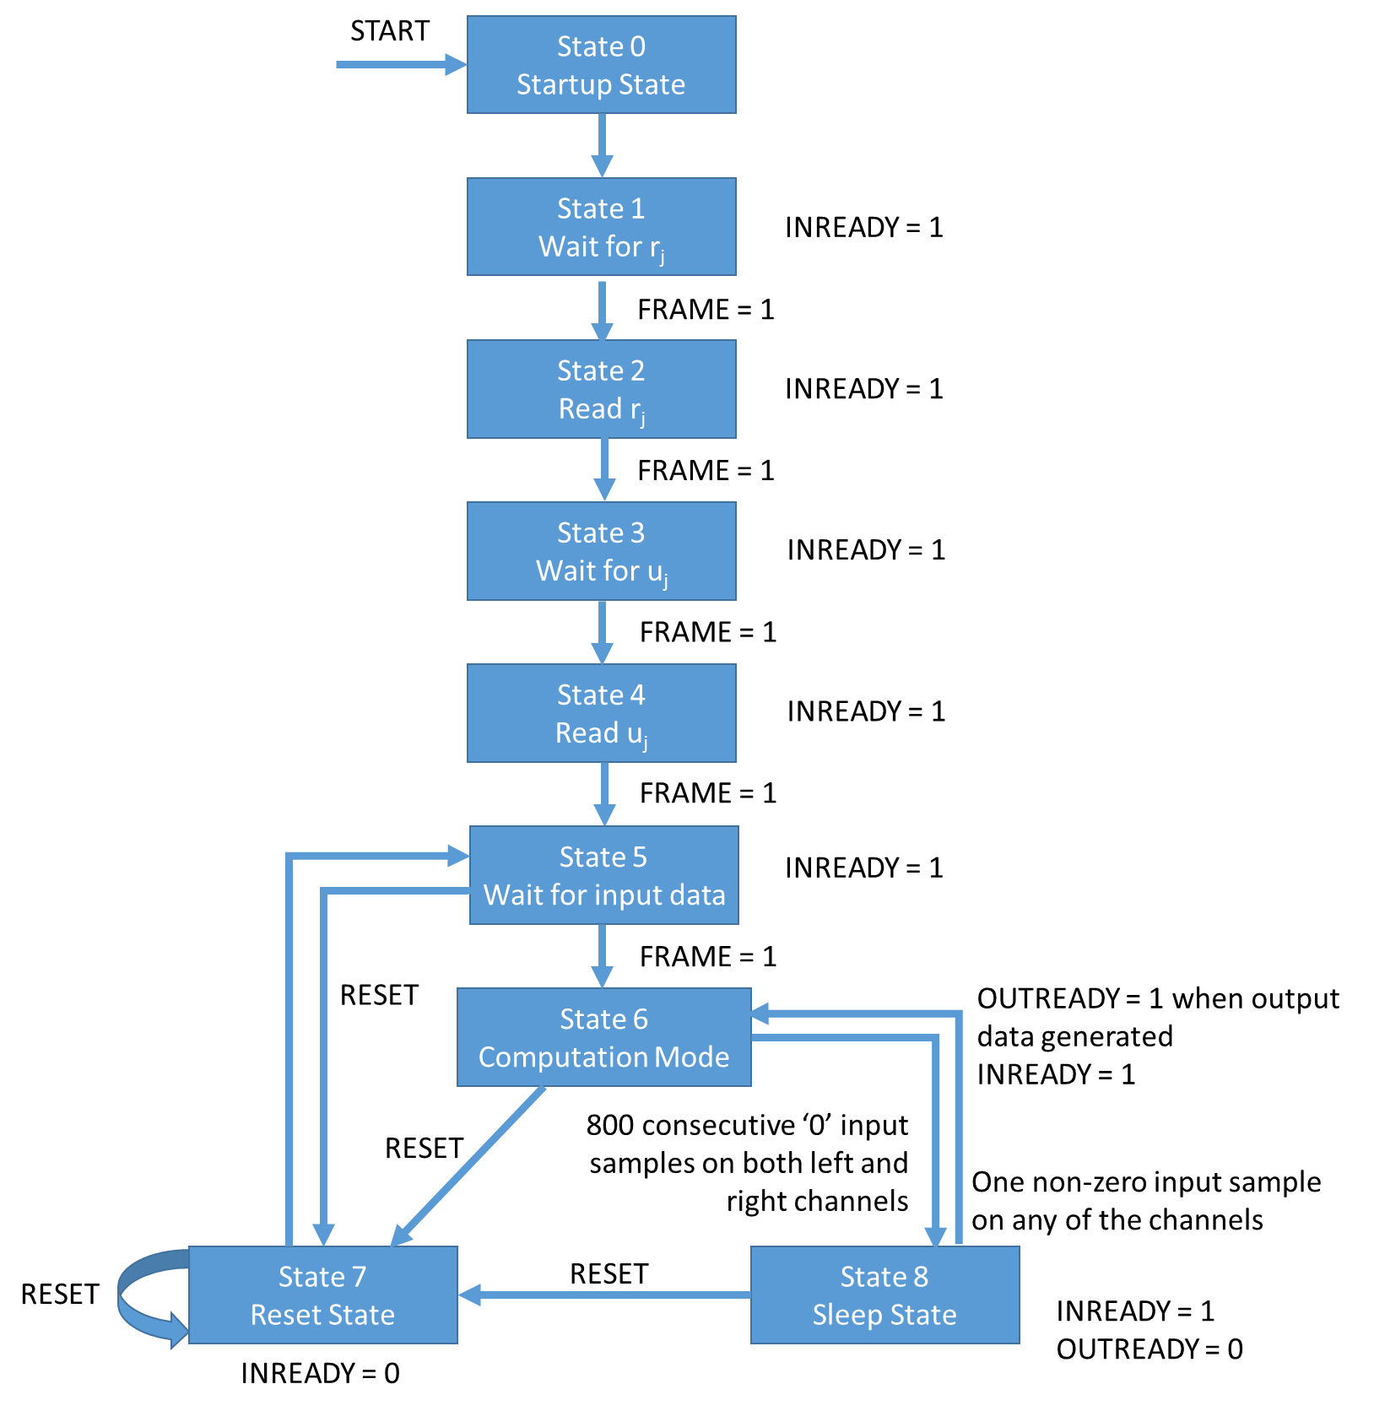
State Description of FSM

Slide 9
Operation Modes
State 0 (Startup State): The START signal, when set high, initializes the chip and prepares it for working by clearing memories and registers, and then the chip enters State 1.
State 1 (Wait for r_{j}): INREADY is set high. If FRAME = 1 is seen on the line, the chip enters state 2.
State 2 (Read r_{j}): The chip starts reading r_{j} values and INREADY remains high. Once all the r_{j} values have been collected, the chip enters state 3.
State 3 (Wait for u_{j}): INREADY is set high. If FRAME = 1 is seen on the line, the chip enters state 4.
State 4 (Read u_{j}): The chip starts reading u_{j} values and INREADY remains high. Once all the u_{j} coefficient values have been collected, the chip enters state 5.
State 5 (Wait for input data): INREADY is set high. If FRAME = 1 is seen on the line, the chip enters State 6. Or else, if RESET_N = 0 is seen, the chip enters State 7.

Slide 10
State 6 (Computation mode): Here the chip accepts incoming input data, computes the output values for convolution, and puts out output values too. INREADY remains high. If RESET_N = 0 is detected, the chip enters State 7. Or else, if 800 consecutive input samples on both channels are detected as zero, the chip enters the Sleep mode (State 8).
State 7 (Reset mode): Here, INREADY is set low. All registers and memories except r_{j} and coefficients are cleared. If RESET_N = 0 is seen on the line, the chip restarts the same process. Once reset is completed, the chip automatically goes to State 5.
State 8 (Sleep mode):
Here, the chip in sleep mode until a non-zero input sample is detected on either left or right channel. INREADY is kept high. If RESET_N = 0 is detected, the chip goes to State 7.

Slide 11
Data Formats
R_{j} format
The r_{j} value is 8 bits long and is stored in the lower half of the 16-bit frame, while the other higher order bits are zero padded to form the frame. The frame is as shown below –
0 | . . . . . . . . . . . . . . . . . . . . . . | 7 | 8 | . . . . . . . . . . . . . . . . . . . . . . | 15
 | Unused/Padded bits |  | MSB | R_{j} data | LSB

Slide 12
U_{j} format
The coefficient u_{j} value is 8 bits long with a sign bit, and the rest of the frame is zero padded. The 16-bit frame is as shown below –
0 | . . . . . . . . . . . . . . . . . . . . . . | 6 | 7 | 8 | . . . . . . . . . . . . . . . . . . . . . . | 15
 | Unused/Padded bits |  | Sign bit | MSB | Coefficient data | LSB
Input/Ouput data format
The input/output data frames are 16 bit 2’s complement values.
0 | . . . . . . . . . . . . . . . . . . . . . . | 15
MSB | Input/output data bits | LSB

Slide 13
Timing Diagram for the input and output
As we see, the FRAME signal is raised high for one clock cycle whenever a new frame with new data starts. The data is transmitted as one bit per clock cycle for 16 cycles of DCLK i.e. for 16 bits. During this time, the INREADY signal is kept high to signal that inputs are ready to be accepted.

Slide 14
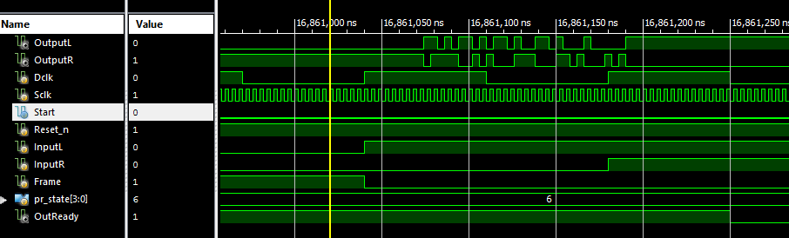
As we see, the FRAME signal works according to DCLK (16 cycles), while OUTREADY and OUTPUTL/R are synchronized according to the system clock SCLK. SCLK depends on the architecture of the implementation. Once OUTREADY is set high, OUTPUTL/R gives the 40-bit output, and once all 40 bits are put on the line, one every clock cycle, and then OUTREADY is set low.

Slide 15
System Settings
The main blocks in the system is ADC, Controller, MSDAP and DAC (Refer Block Diagram above)
ADC: Analog to Digital Converter is used to convert the analog audio samples to digital values. The analog data is sampled at the rate of 48 KHz.
Controller: Controller is responsible for generating the control signals to the MSDAP. It also sends the converted digital samples from ADC to the MSDAP at the rate of Dclk for the computation. After the computation, MSDAP sends the output samples to the controller at the rate of Dclk which is 768 KHz.
MSDAP: MSDAP is responsible for the computation on the received input samples. The computation is carried out at the rate of Sclk which is 26.88MHz. For one complete computation on the input data sample, the number of Sclk cycles required will determine the frequency of operation of MSDAP chip. For one computation, 512 additions and 16 shifts are required. Rj value add upto a total of 512, requiring 512 additions/subtractions to calculate 16 U values. After each U value calculation, it is to be shifted once. Hence, a total of 528 Sclk cycles are required. Based on these calculations, we decided the Sclk frequency to be 26.88MHz and Dclk frequency to be 768 KHz.
DAC: Once the output digital samples are received by the Controller, it is fed to the Digital to Analog Converter that converts the digital samples to actual audio output signals.

Slide 16
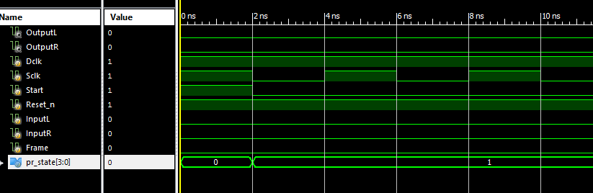
Simulation Results
Start

Slide 17
Transition from State 0 to State 1

Slide 18
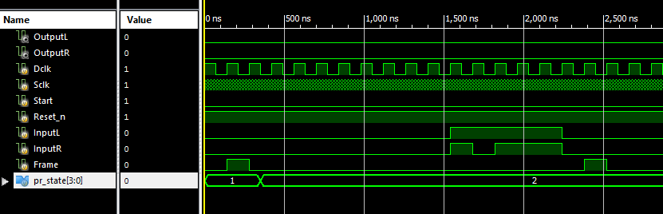
Transition from State 1 to State 2

Slide 19
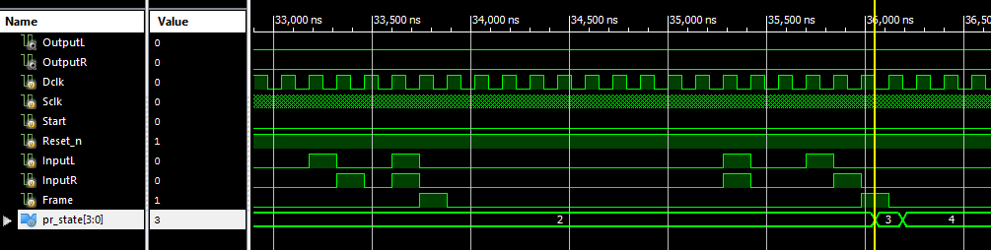
Transition from State 2 to State 3

Slide 20
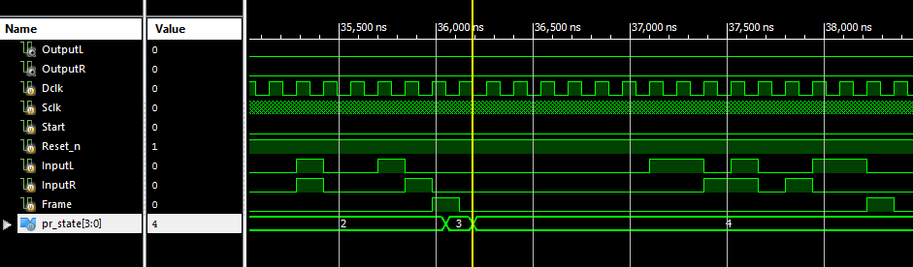
Transition from State 3 to State 4

Slide 21
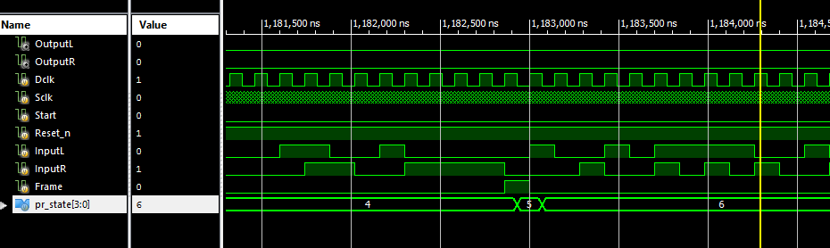
Transition from State 4 to State 5

Slide 22
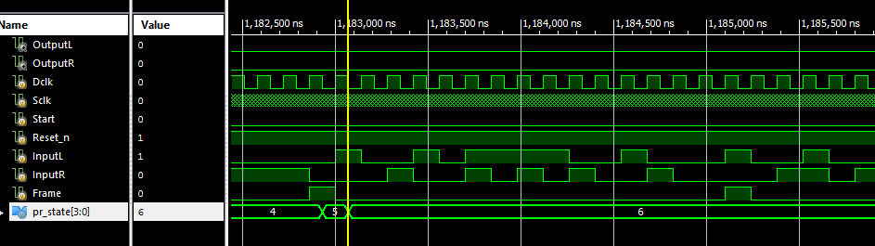
Transition from State 5 to State 6

Slide 23
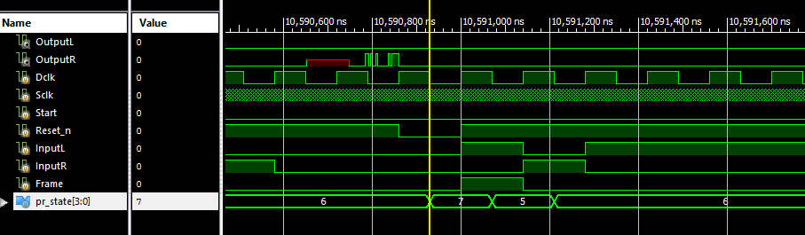
Transition from State 7 to State 5

Slide 24
Working in State 6

Slide 25
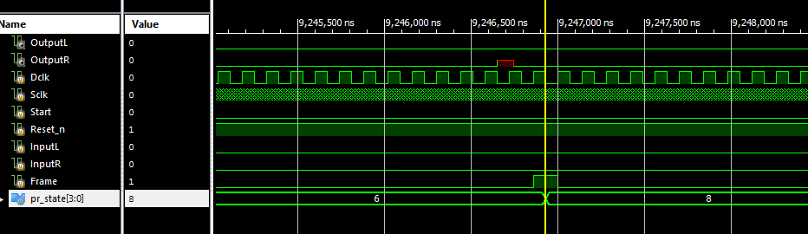
Transition from State 6 to State 8

Slide 26
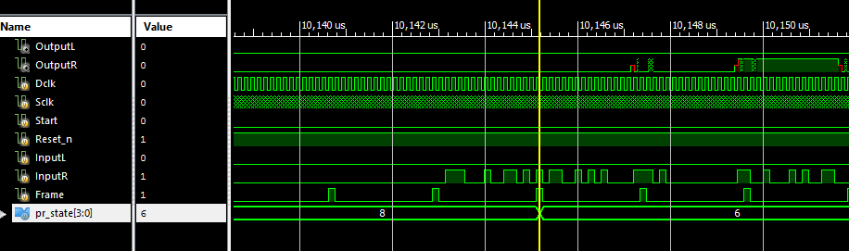
Transition from State 8 to State 6

Slide 27
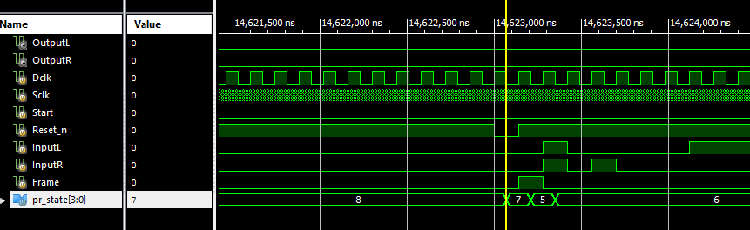
Transition from State 8 to State 7

Slide 28
Transition from State 6 to State 7

Slide 29
Physical Design Flow
Physical Design flow starts right after the circuit design and logical verification of the gate level net list.
Gates are converted to represent the actual layers of the component which is later used for fabrication.
Gates from the net list are mapped with the equivalent layouts at the end of physical design which gives complete actual reliable information about the critical path, RC delays, power consumption, area and timing.
Physical design flow is as shown in the figure below.

Slide 30
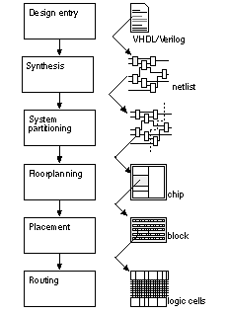
Physical Design Flow

Slide 31
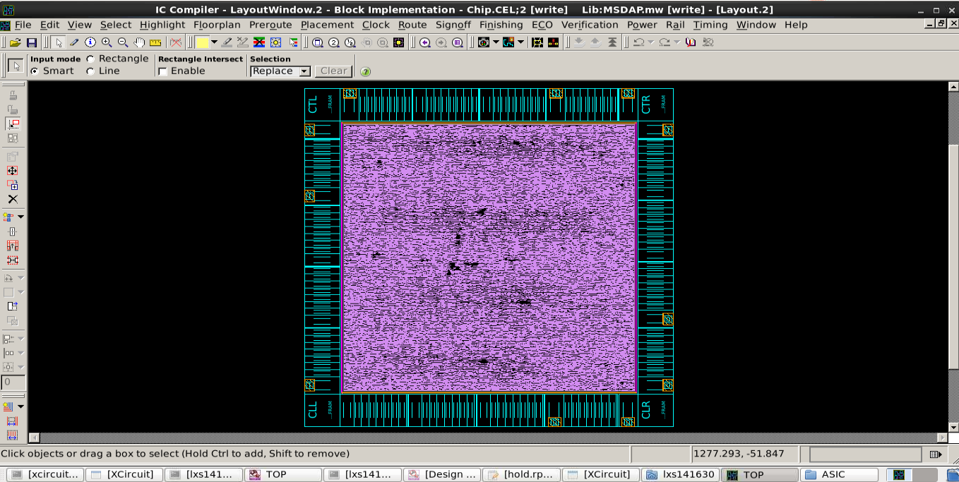
Optimization
Layout View: For 60% utilization
Std cell utilization: 60.59% (1215639/(2006250-0)) (Non-fixed + Fixed)
Std cell utilization: 60.59% (1215639/(2006250-0)) (Non-fixed only)
Chip area : 2006250 sites, bbox (258.00 258.00 2358.00 2355.20) um
Std cell area : 1215639 sites, (non-fixed:1215639 fixed:0)
77545 cells, (non-fixed:77545 fixed:0)
Lib cell count : 116

Slide 32
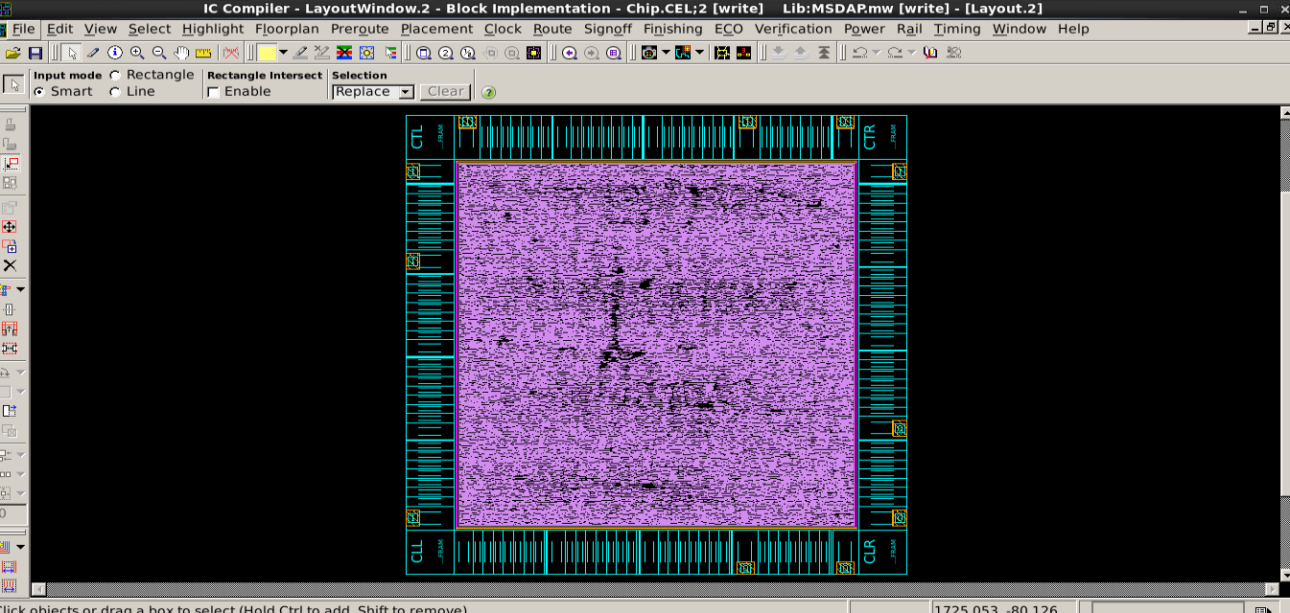

Slide 33
Summary of the results
Std Cell Utilization | 60.59% | 70.14%
Chip area | 2006250um2 | 1722112um2
Std cell area | 1215639um2 | 1207834um2
Lib cell count | 116 | 126
Total Dynamic Power | 3.5728 mW | 3.5517 mW
Cell Leakage Power | 106.1986 uW | 106.1446 uW
Frequency of Sclk | 37.2 ns | 37.2ns
Slack | Met | Met

Slide 34
Conclusion
ASIC Design flow of MSDAP is successfully completed.
RTL Verilog code for MSDAP was written and tested using test bench.
Timing reports was generated and slack has been met.
Layout of the MSDAP chip has been implemented using IC compiler.
After Physical design, the chip area was found to be 1722112 after optimization

